Slide 1


Slide 2

Contents
Introduction
Geographical locations and stats
Reviews and Heat Mapped Ratings
Visitor Experience and Revenue
Demonstration

Slide 3

Introduction
Audience
United States Travel and Tourism Administration
Purpose
Market Museums as Travel Hotspots (for National & International Tourists)
Dashboard
High-level View of Locations
Top State and Major City Counts
Heatmap of Rated Museums to Major cities
Top-Rated and Reviewed Museums
View of Income/Revenue in prox. to Major Cities

Slide 4
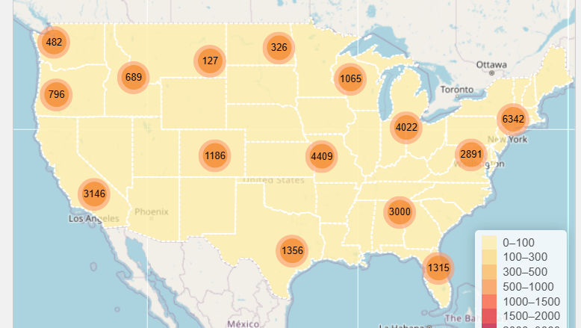
Geographical locations

Slide 5

Stats
33,000 museums
Top states with museums
Max museum and state:
(lowest count within the top 10) Min museum and state:
Top Major Cities with museums
Max museum and city
(lowest count) Min museum and city

Slide 6
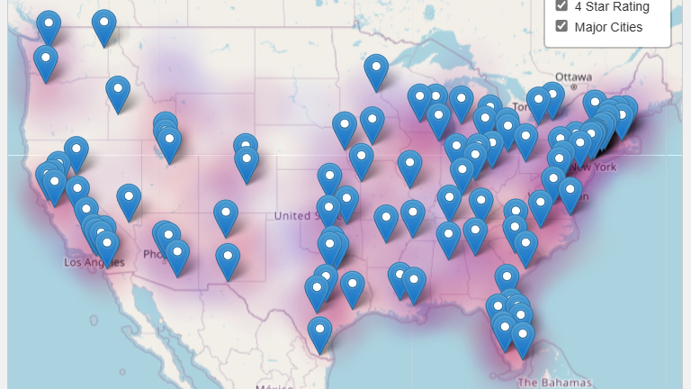
Heat Mapping of Ratings

Slide 7

Reviews
Ratings
View provides an outlook of Museum Averages
Review Count
Provides an overview of attendance
Attendees impacted to review Museum

Slide 8
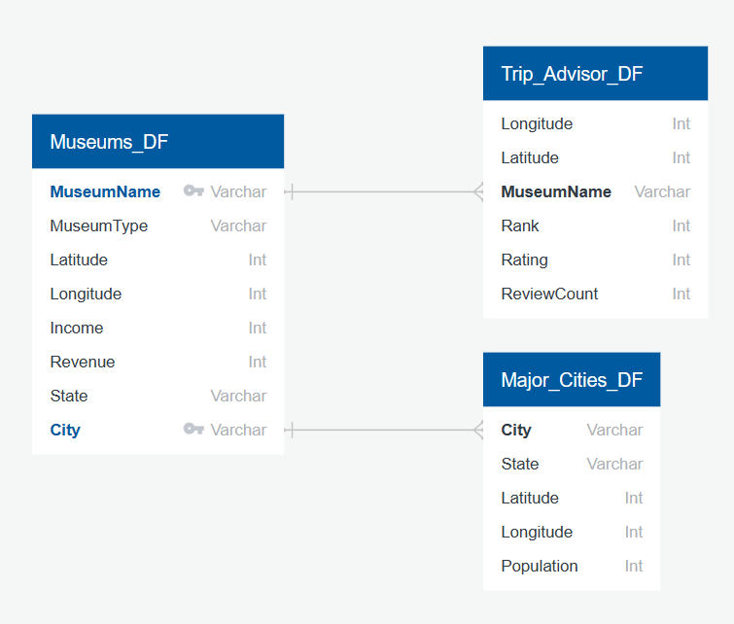
Database Schema

Slide 9
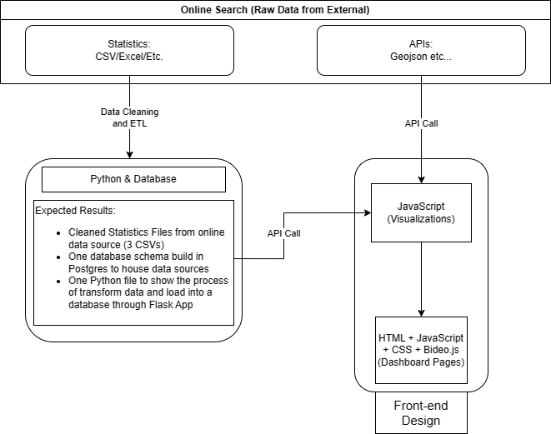
Architecture

Slide 10
Demonstration

Slide 11

Questions?

Slide 12

Thank You

Slide 13
Appendix

Slide 14
Financial Location of Museums

Slide 15

Revenue
Largest Revenue Generation
Research based
Smallest Revenue Generation
Exhibitions only
Length of stay
By length of Stay
By type of exhibition, etc

